Slide 1

TaintStream: Fine-Grained Taint Tracking for Big Data Platforms through Dynamic Code Translation
Chengxu Yang, Yuanchun Li, Mengwei Xu, Zhenpeng Chen
Yunxin Liu, Gang Huang, Xuanzhe Liu
Notes:
Hello everyone, I’m chengxu from Peking University. Today I’m going to share with you our recent work, TaintStream

Slide 2











Privacy Compliance in Big Data Platforms
Data audit team
Ensure privacy compliance of data and scripts
Name | Email | Date
Alice | Hi there, … | 07/11
Bob | Let’s meet … | 06/30
Clare | Dear Prof. … | 06/01
… | … | …
df.filter(date > 06/01)
.groupBy(name)
.aggregate(wordCount)
…
Provide raw data
Submit scripts to process data
Data provider (e.g. end-users and customers)
Data analysts
(e.g. developers and researchers)
Notes:
Today, most companies including Microsoft are managing data within a shared platform, where the raw data comes from the end-users or customers, and data analysts can access and process the data by submitting scripts.
Due to the sensitivity of the data and various government regulations like GDPR, we usually need a group of people to audit the scripts and data to ensure privacy compliance.
GDPR story
What is the thinking and insight. In practice, it’s about compliance with gov regulation
Data audit team: O365 Trust Audits team
M365's Compliance Principles - Substrate Dev Center (microsoft.net)
https://aka.ms/aml/compliant
privacy compliance on data platform
弱化audit

Slide 3

Privacy Compliance in Big Data Platforms
User data can be used only if:
The requester has the permission
Data is within retention period
Data is properly anonymized
The user doesn’t choose opt-out
…
Privacy requirements
(e.g. GDPR, HIPAA, COPPA, data provider’s requirements, etc.)
Notes:
However, the current practice of privacy compliance for big data platforms still has much room for improvement.
For example, there are lots of privacy requirements to comply with, like the data can only be accessed by developers with proper permissions, any data should be deleted after retention period, and so on.

Slide 4
Privacy Compliance in Big Data Platforms
User data can be used only if:
The requester has the permission
Data is within retention period
Data is properly anonymized
The user doesn’t choose opt-out
…
Privacy requirements
(e.g. GDPR, HIPAA, COPPA, data provider’s requirements, etc.)
Current practice:
Lots of manual code/data review
Case-by-case solution for each privacy requirement
Only support coarse-grained data management
Notes:
Based on our conversations with the product team. The current practice is to deal with each privacy requirement case by case, for example, the access control is achieved by managing the datasets and storage with security groups, the data retention is enforced by partitioning the raw data into daily chunks, and user-related management is achieved by keeping the user identifier in each dataset. Both the auditors and developers are required to learn the rules, and extensive manual code review is required to ensure the compliance.

Slide 5
Privacy Compliance in Big Data Platforms
User data can be used only if:
The requester has the permission
Data is within retention period
Data is properly anonymized
The user doesn’t choose opt-out
…
Privacy requirements
(e.g. GDPR, HIPAA, COPPA, data provider’s requirements, etc.)
Current practice:
Problems:
Lots of manual code/data review
Time-consuming
Case-by-case solution for each privacy requirement
Error-prone
Only support coarse-grained data management
Data fragmentation & redundancy
A more systematic solution is needed!
Notes:
Such mechanisms have led to several problems including the time-consuming and error-prone review process, and data fragmentation and redundancy issues.
Thus, we believe that a more systematic solution is needed for privacy compliance.
Current practice:
Manual
Unsound
需要更加systemetic的solution
-> Big data platform的不同（challenge）：Spark的runtime难改，要从script和data角度解决
用框把下边左右各3个框

Slide 6
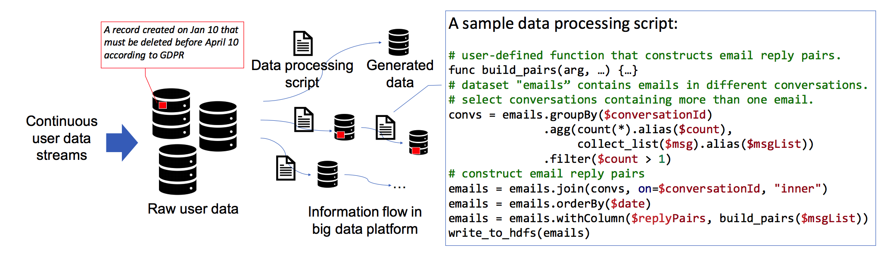
An Example
Sensitive information may be propagated across various datasets
Data is transformed by complicated scripts
Different compliance policies need to apply to all the datasets
Notes:
Here is an example to illustrate the problem we want to solve.
First, Sensitive information may be propagated across various datasets, which could be a source data stream or intermediate datasets.
Second, Data is transformed by complicated scripts written in declarative languages. Here shows a script that uses the Spark SQL API and is used to construct email replay pairs.
Third, Different compliance policies need to apply to all the datasets. Here we take the data retention requirement as the example, According to GDPR, any sensitive raw data and the data inferred from it must be deleted after a certain retention period.
Suppose there is a user data stream continuously uploaded to the cloud. According to GDPR, any sensitive raw data and the data inferred from it must be deleted after a certain retention period.
For example, a record created on Jan 10th must be deleted by April 10th.
There are several problems to handle with:
In the big data platform, the raw data is processed by various developer-uploaded scripts to produce many intermediate datasets, thus the sensitive information is propagated across many datasets.
To enforce compliance, different compliance policies need to be applied to all the datasets
提一下code，motivating -> an

Slide 7
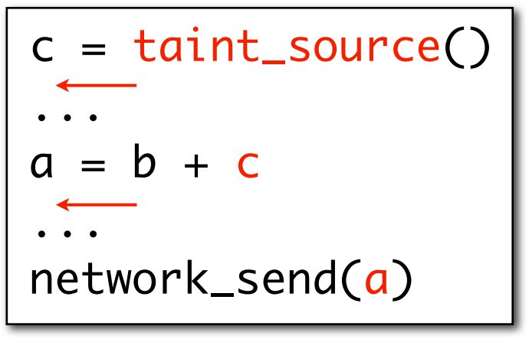
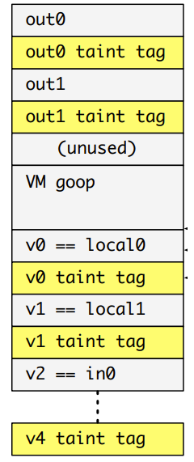
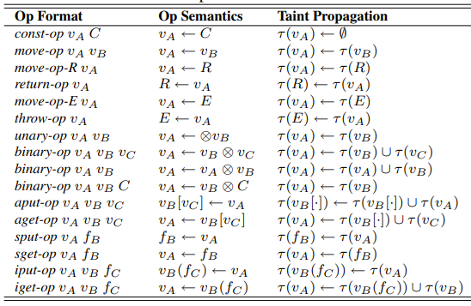
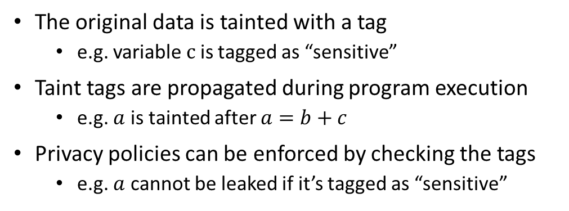
Potential Solution: Taint Tracking
The original data is tainted with a tag
e.g. variable $c$ is tagged as “sensitive”
Taint tags are propagated during program execution
e.g. $a$ is tainted after $a=b+c$
Privacy policies can be enforced by checking the tags
e.g. $a$ cannot be leaked if it’s tagged as “sensitive”
Typical way to achieve taint tracking:
System modification
Add a taint tag field to each register/variable
Propagate taint tags in each operator
[TaintDroid OSDI’10, LIFT MICRO’06]
Notes:
To solve this kind of privacy protection problems, taint tracking is a well-known and promising approach.
The most common way to achieve this goal is through system modification. For example, one can modify the heap and stack structure to store taint tags, then modify the logic of basic instructions to propagate them.
While the concept of taint tracking looks promising, it is rarely used in real big data platforms.

Slide 8
Challenges
Privacy compliance is not a set of precise computational rules
The taint tags should be flexible enough to support diverse privacy polices
Big data platforms are complex and difficult to do system hacking
Runtime modification is unwanted for security and maintainability reasons
Static approaches usually have oversimplified assumptions for real programs
Data schema is difficult to infer statically
Taint flexibility required
System modification unwanted
Runtime information needed
Notes:
So we want to explore, how can we adopt taint tracking to big data platforms for privacy compliance.
First, compliance is usually about laws and regulations instead of xxx. we need to make sure the tagging mechanism is flexible enough to support diverse privacy policies.
Second, since big data platforms are usually very complicated, system modification is usually unwanted for security and maintainability reasons.
Third, most static taint analysis approaches can not apply as well, because they often need to extract information flow between variables, which is difficult in big data processing scripts due to the missing data schema.

Slide 9
Our approach (TaintStream)
Idea: Statically rewrite the script to let it self-translate at runtime and propagate taint tags embedded in data frames. Meanwhile, support diverse compliance requirements with formal and flexible policy definition.
Notes:
To tackle with these challenges, we designed TaintStream, the key idea is that xxx

Slide 10

Our approach (TaintStream)
Idea: Statically rewrite the script to let it self-translate at runtime and propagate taint tags embedded in data frames. Meanwhile, support diverse compliance requirements with formal and flexible policy definition.
Create a parallel element to store taint tags for each data element
The tag type can be flexibly customized according to the privacy policy
Annotate the scripts through static code instrumentation
Program logic is changed by modifying the scripts instead of the system
Complete translation at runtime and propagate taint tags on the fly
Data schema is obtained in the dynamic context
Inspirations from source-to-source compilation approaches [JFlow POPL’99, TaintART CCS’16], while tailored for big data processing.
Notes:
Specifically, we explain how taintstream solves the aforementioned problems
For tag flexibility, we create a parallel element to store taint tags and the tags can be customized easily according to the requirments.
To avoid system modification, taintstream annotates the scripts through static code instrumentation.
To acquire runtime information, the instrumented scripts complete translation at runtime and propagate taint tags on the fly

Slide 11
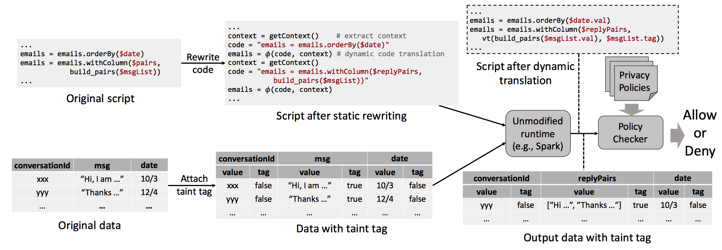




Workflow of TaintStream
Notes:
This is an illustration of the TaintStream workflow, which contains mainly four steps:
The original data schema is extended to attach a taint tag for each element.
The submitted script is rewritten statically to wrap each data operation with a translation function phi.
The rewritten script is executed in the unmodified runtime to complete the translation. The output dataset will automatically contain computed taint tags.
Finally, the privacy policies can be enforced on the datasets with taint tags.
图拆开，加动画

Slide 12
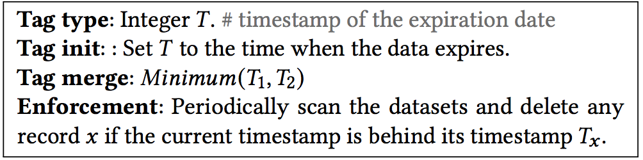
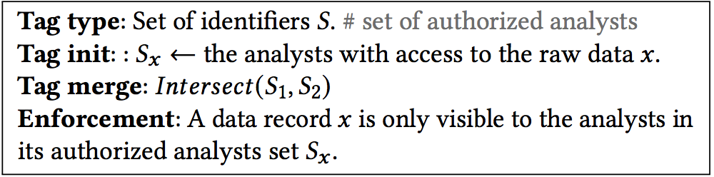
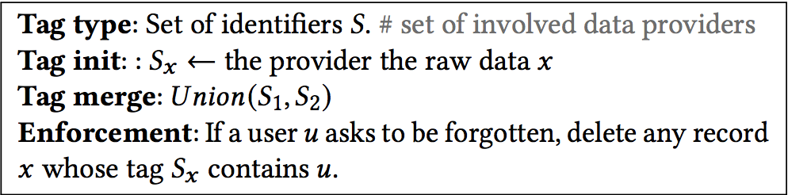
Flexible support of diverse privacy management tasks
Data Retention (GDPR)
The raw data and the data inferred from it must be deleted after a certain retention period (e.g., three months)
Access Control (organizational)
The access to certain data should be restricted if the requester is unauthorized.
User Data Erasure (GDPR)
When a user requests to be forgotten, the data collected from him/her and generated based on it must be deleted.
Notes:
TaintStream is able to flexibly support diverse privacy management tasks.
For each privacy management task, the auditors only need to define the tag type, tag initialization, and tag merging functions.
For example, in data retention, the tag type is an integer representing the expiration date of the record. Then when we generate an output record, its expiration date is computed as the minimum of all its input records.
When we are about to clean the expired data, we only need to scan the dataset once and delete the records that have reached the expiration date.

Slide 13
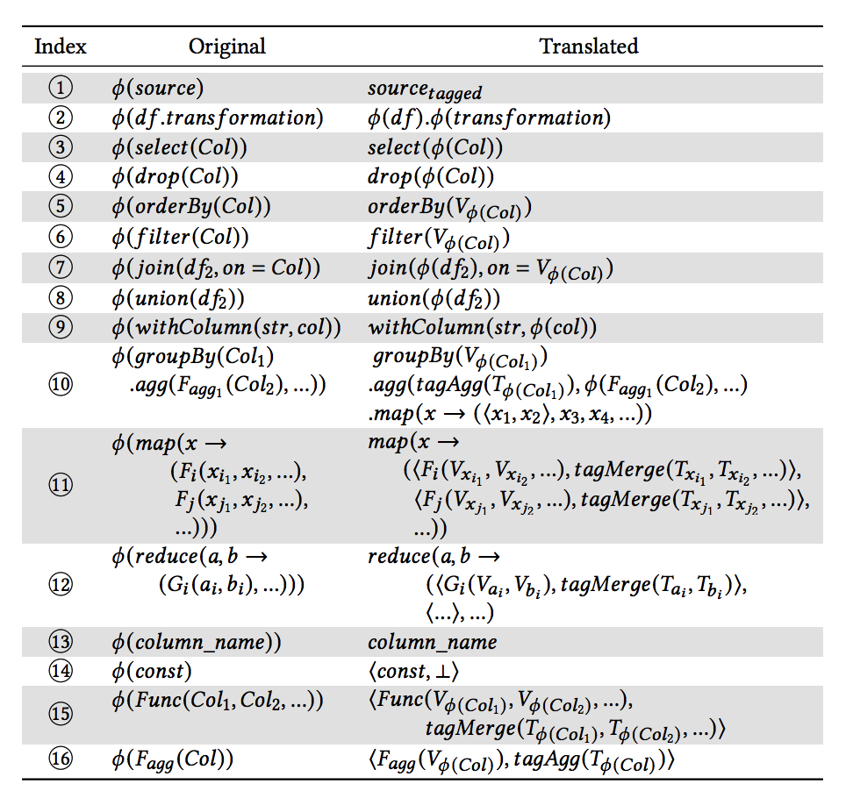
Dynamic translation
Parse the code at runtime and recursively apply the rules until no rule can apply.
Two design principles of translation rules:
(Non-interference) The translated code must not change the effect of the original code.
(Conservativeness) Should not tolerant false negatives.
Other designs:
Correctness guarantee: Formally prove the non-interference property of the rules
Exception handling: Snapshot and fallback to the conservative taint status on exceptions
Performance optimization: Fuse non-conflicting taint propagation operations to save time
Translation rules subset
Notes:
The core of our approach is the runtime code translation, which is achieved by parsing the code and applying a set of translation rules recursively. The translation rules are designed by following two principles including non-interference and conservativeness. Specifically, for many-to-one and many-to-many operations, the rules need to be carefully designed to ensure identical effect on completely different data schema.
There are also several technical details including correctness guarantee based on formal proofs, exception handling based on snapshots, and performance optimization based on operation fusion.

Slide 14
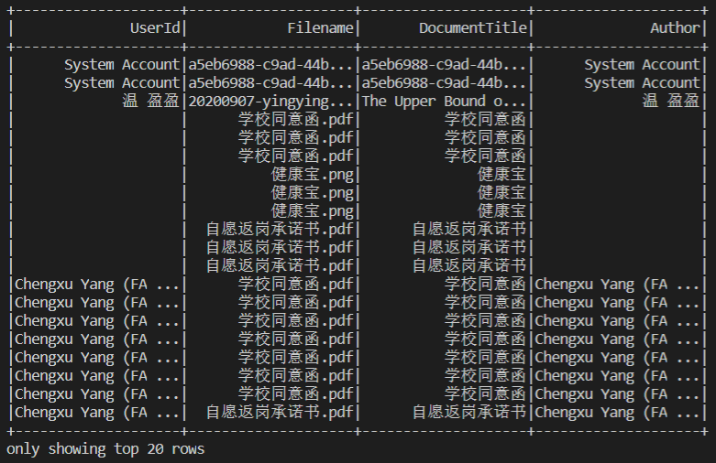
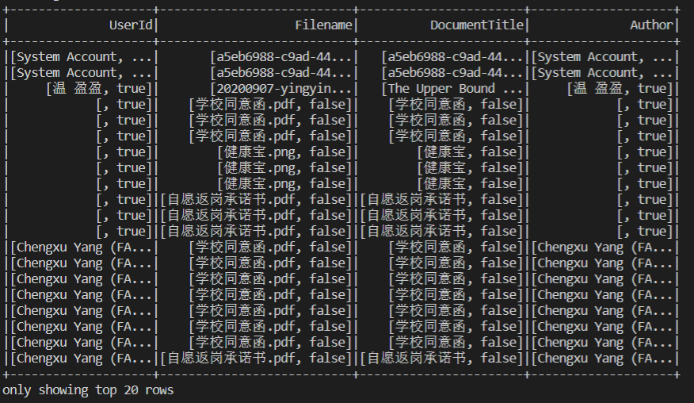
Demo: The datasets in TaintStream with taint tags
Example: each taint tag is a Boolean value
The output dataset of the original script
The output dataset when running with TaintStream
Notes:
Here is a demonstration of the effect of TaintStream. The output dataset has 4 columns. You can notice that the dataset generated by TaintStream contains a Boolean taint tag for each data cell. Note that tags here can be customized flexibly.

Slide 15
Experiment setup
Query scripts: 7 real-world scripts and 33 self-built scripts
Baseline: PlanAnlyzer, PySa (SOTA static analyzers)
Environment: 4-node cluster
Metrics:
precision, recall
running time, storage overhead
Notes:
Finally, we evaluate TaintStream using both real-world scripts and self-built benchmark scripts.
We compared with existing static analyzers in terms of precision, recall, and running time and storage overhead.

Slide 16
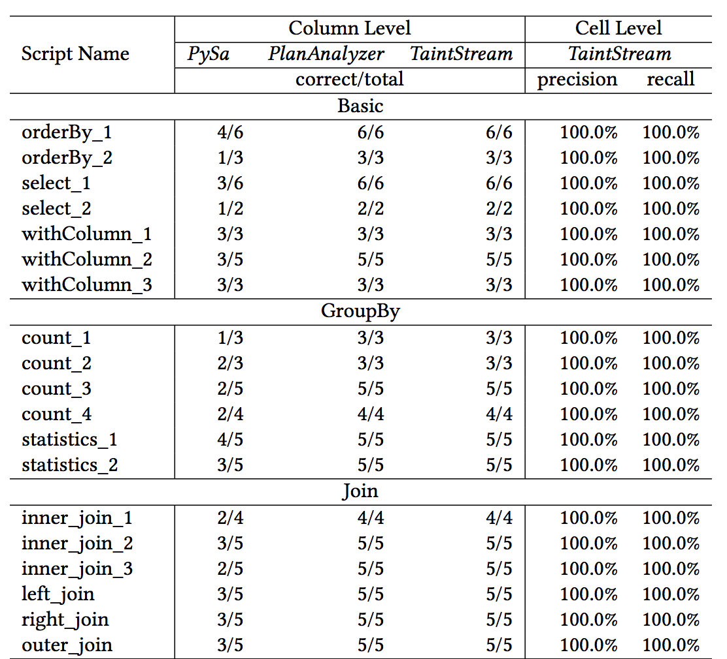
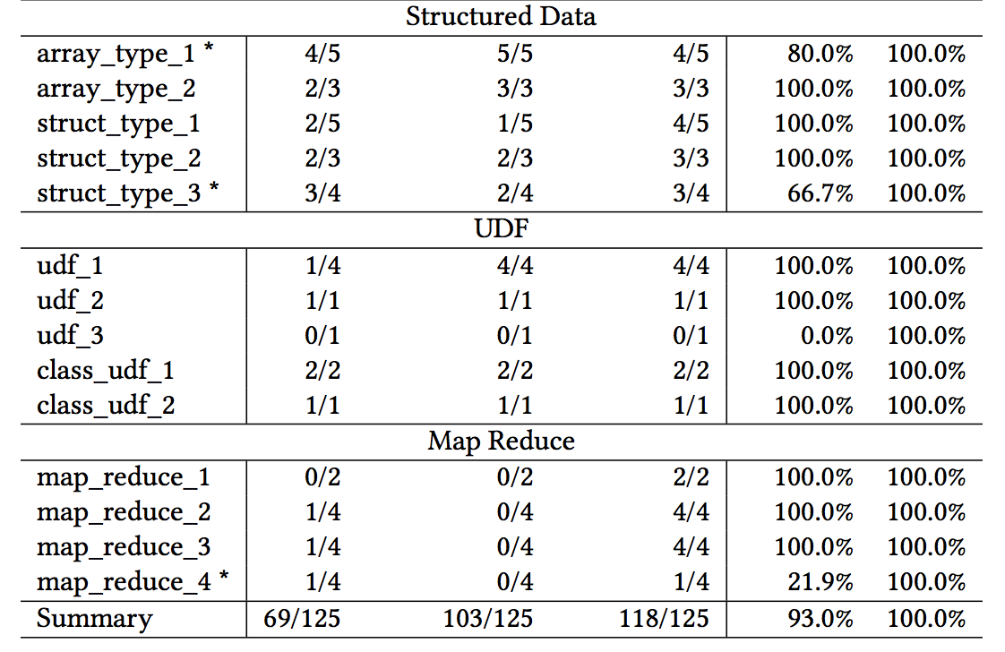
Accuracy
93.0% precision and 100% recall
Notes:
For the accuracy of the taint tracking. To the best of our knowledge, existing methods can support only column level tracking due to the challenges we listed before. So we compare TaintStream with them at column level. The results show that TaintStream outperforms them by precisely tracking more columns.
Meanwhile, TaintStream is designed to support fine-grained taint tracking, i.e., cell-level. We perform a cell-level evaluation and TaintStream achieves a 93.0% precision and 100% recall.

Slide 17
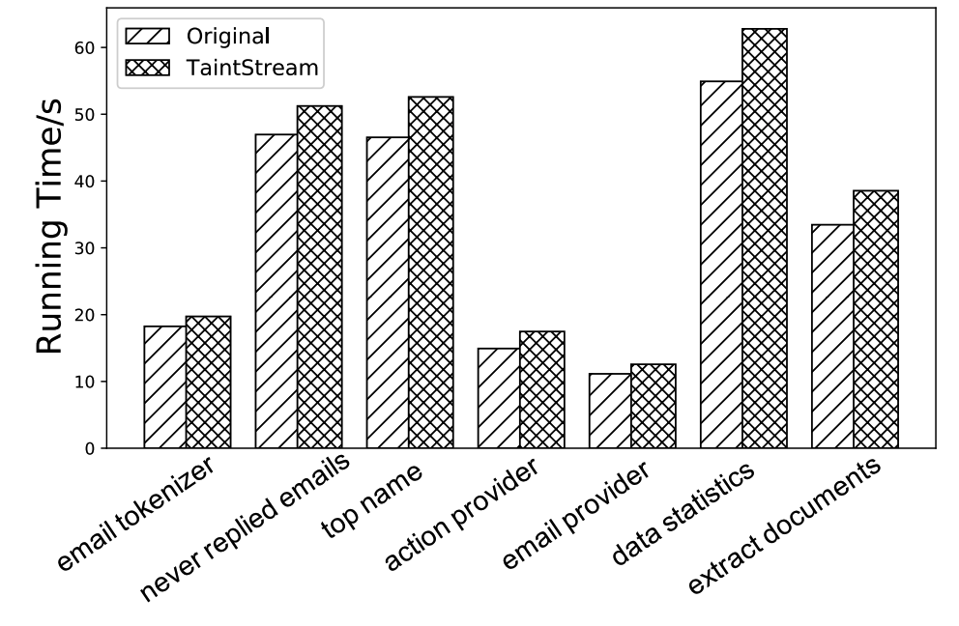
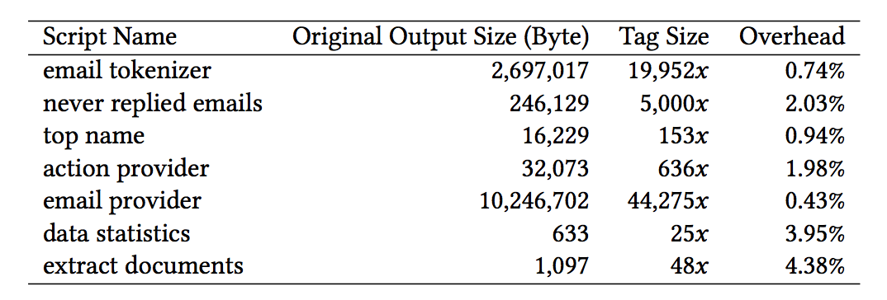
System Overhead
12.7% running time overhead
2.06% storage overhead
Notes:
What is more, the system overhead of TaintStream is low due to our design tailored for big data processing operations.

Slide 18
Take Away
Light-weight fine-grained taint tracking for big data platforms
Various privacy management tasks with little overhead
With no changes to the system and developers
Thanks!
Data and framework:
https://github.com/PrivacyStreams/TaintStream
yangchengxu@pku.edu.cn
Notes:
We achieve light-weight fine-grained taint tracking for big data platforms through dynamic code translation.
TaintStream can automatically support various privacy management tasks with little overhead.
TaintStream can be easily integrated into existing platforms without any changes to the system and developers.

